Slide 1
Functions

Slide 2
Example
int max(int a, int b);
void main(){
int x;
x = max(5,8);
x = max(x,7);
}
int max(int a, int b){
return a>b?a:b;
}

Slide 3
Void main()
{
Int a, b=8,c=4;//global variable
c=a+b;
Printf(“%d”,c)
//user defined function
int max(int a, int b)//local variable
{
return a>b?a:b;
}
}

Slide 4
Void main()
{
char dept[5] = “CSE”; //global variable to declare a string
//functions
int csc183_A() {}
int csc183_B() {}
int csc183_C() {}
int csc183_D() {}
int csc183_E(int numofstudent) {
Numofstudent = 30;
}
int csc183_F(int numofstd)
{
numofstd=17;//local
}
}

Slide 5
int run()
{
printf(“Today the weather is very unpleasant”);
return 0;
}
int run(int a, int b)
{
return(a+b);
}

Slide 6
What is a C Function?
A function receives zero or more parameters, performs a specific task, and returns zero or one value.
A function is invoked by its name and parameters.
  No two functions have the same name in your C program.
  The communication between the function and invoker is through the parameters and the return value.
A function is independent:
  It is “completely” self-contained.
  It can be called at any places of your code and can be ported to another program.
Functions make programs reusable and readable.

Slide 7
Void main()
{
int a,b;//access
int func1(int a, int b){printf(a)}
int func2(){……….}
}

Slide 8
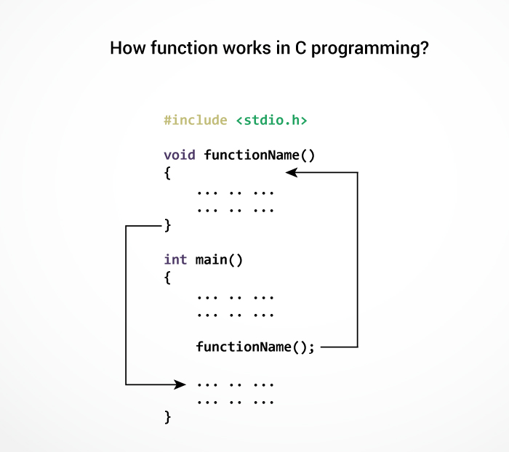

Slide 9
Syntax
Function Prototype:
    return_type function_name (type1 name1, type2 name2,
    ..., typen namen);
Function Definition:
    return_type function_name (type1 name1, type2 name2, ...,typen namen)
    {
    ....statements...
    }
The parameters
Function header

Slide 10
Some Examples
Function Prototype Examples
    double squared (double number);
    void print_report (int);
    int get _menu_choice (void);
Function Definition Examples
    double squared (double number)
    {
    return (number * number);
    }
    void print_report (int report_number)
    {
    if (report_nmber == 1)
    printf(“Printer Report 1”);
    else
    printf(“Not printing Report 1”);
    }
void parameter list means
it takes no parameters
return type void means
it returns nothing

Slide 11
Example
#include <stdio.h>
int addNumbers(int a, int b); // function prototype
int main()
{
int n1,n2,sum;
printf("Enters two numbers: ");
scanf("%d %d",&n1,&n2);
sum = addNumbers(n1, n2); // function call
printf("sum = %d",sum);
return 0;
}
int addNumbers(int a,int b) // function definition
{
int result;
result = a+b;
return result; // return statement
}

Slide 12
Passing Arguments
Arguments are passed as in Java and Pascal
Function call:
    func1 (a, b, c);
Function header
    int func1 (int x, int y, int z)
  Each argument can be any valid C expression that has a value:
  For example:
    x = func1(x+1,func1(2,3,4),5);
Parameters x y z are initialized by the value of a b c
Type conversions may occur if types do not match.

Slide 13
Parameters are Passed by Value
All parameters are passed by value!!
  This means they are basically local variables initialized to the values that the function is called with.
  They can be modified as you wish but these modifications will not be seen in the calling routine!
  #include<stdio.h>
  int twice(int x)
  {
  x=x+x;
  return x;
  }
  int main()
  {
  int x=10,y;
  y=twice(x);
  printf("%d,%d\n",x,y);
  }

Slide 14
Returning a Value
To return a value from a C function you must explicitly return it with a return statement.
Syntax:
  return <expression>;
  The expression can be any valid C expression that resolves to the type defined in the function header.
  Type conversion may occur if type does not match.
  Multiple return statements can be used within a single function (eg: inside an “if-then-else” statement…)

Slide 15
Local Variables
Local Variables
  int func1 (int y)
  {
  int a, b = 10;
  float rate;
  double cost = 12.55;
  .......
  }
Those variables declared “within” the function are considered “local variables”.
They can only be used inside the function they were declared in, and not elsewhere.

Slide 16
A Simple Example
  #include <stdio.h>
  int x=1; /* global variable - bad! */
  void demo(void);
  void main() {
  int y=2; /* local variable to main */
  printf ("\nBefore calling demo(), x = %d and y = %d.",x,y);
  demo();
  printf ("\nAfter calling demo(), x = %d and y = %d.\n",x,y);
  }
  void demo () {
  int x = 88, y =99; /* local variables to demo */
  printf ("\nWithin demo(), x = %d and y = %d.",x,y);
  }

Slide 17
Types
Function with no arguments and no return value
Function with no arguments and a return value
Function with arguments and no return value
Function with arguments and a return value.

Slide 18
Function with no arguments and no return value
#include <stdio.h>
void checkPrimeNumber();
int main()
{
checkPrimeNumber(); // no argument is passed to prime()
return 0;
}
// return type of the function is void becuase no value is returned from the function
void checkPrimeNumber()
{
int n, i, flag=0;
printf("Enter a positive integer: ");
scanf("%d",&n);
for(i=2; i <= n/2; ++i)
{
if(n%i == 0)
{
flag = 1;
}
}
if (flag == 1)
printf("%d is not a prime number.", n);
else
printf("%d is a prime number.", n);
}

Slide 19
Function with no arguments and a return value
#include <stdio.h>
int getInteger();
int main()
{
int n, i, flag = 0;
// no argument is passed to the function
// the value returned from the function is assigned to n
n = getInteger();
for(i=2; i<=n/2; ++i)
{
if(n%i==0){
flag = 1;
break;
}
}
if (flag == 1)
printf("%d is not a prime number.", n);
else
printf("%d is a prime number.", n);
return 0;
}
// getInteger() function returns integer entered by the user
int getInteger()
{
int n;
printf("Enter a positive integer: ");
scanf("%d",&n);
return n;
}

Slide 20
Function with arguments and no return value
#include <stdio.h>
void checkPrimeAndDisplay(int n);
int main()
{
int n;
printf("Enter a positive integer: ");
scanf("%d",&n);
// n is passed to the function
checkPrimeAndDisplay(n);
return 0;
}
// void indicates that no value is returned from the function
void checkPrimeAndDisplay(int n)
{
int i, flag = 0;
for(i=2; i <= n/2; ++i)
{
if(n%i == 0){
flag = 1;
break;
}
}
if(flag == 1)
printf("%d is not a prime number.",n);
else
printf("%d is a prime number.", n);
}

Slide 21
Function with arguments and a return value.
int main()
{
int n, flag;
printf("Enter a positive integer: ");
scanf("%d",&n);
// n is passed to the checkPrimeNumber() function
// the value returned from the function is assigned to flag variable
flag = checkPrimeNumber(n);
if(flag==1)
printf("%d is not a prime number",n);
else
printf("%d is a prime number",n);
return 0;
}
// integer is returned from the function
int checkPrimeNumber(int n)
{
/* Integer value is returned from function checkPrimeNumber() */
int i;
for(i=2; i <= n/2; ++i)
{
if(n%i == 0)
return 1;
}
return 0;
}

Slide 22
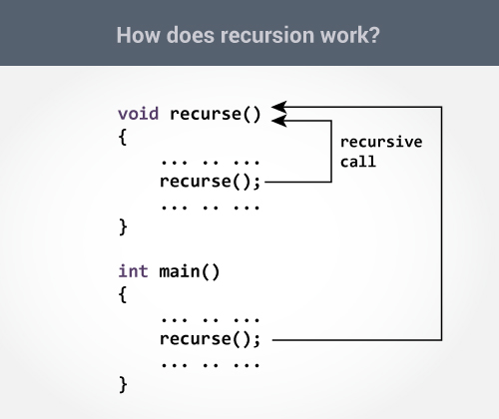
Recursion

Slide 23
Recursion - An Example
unsigned int factorial(unsigned int a);
void main () {
unsigned int f,x;
printf("Enter value between 1 & 8: ");
scanf("%d", &x);
if (x > 8 || x < 1)
printf (”Illegal input!\n");
else {
f = factorial(x);
printf ("%u factorial equals %u\n", x,f);
}
}
unsigned int factorial (unsigned int a) {
if (a==1)
return 1;
else {
a *= factorial(a-1);
return a;
}
}

